Slide 1

Candace Moore
CS 211 – Data Structures
Notes:
-This semester was obviously hard and unique
-I feel like I used the time wisely, and spent several hour and days programming after recovering from back surgery.
-I spent many hours on my little cocktail application that I designed.
-I designed the GUI with WinForms using Visual Studio in C#
-There are definitely logical flaws, but there are a lot of cool features I’m proud to have accomplished.
-I’m glad it’s almost over
I decided to create an application that had the possibility of expansion for POS integration or inventory management. I was inspired by work because after a long
day, nothing beats a tasty cocktail. This application would be useful if someone is interested in having an online drink data base which gives you the ability to
filter by the glass or ingredients, and also shows a list of popular drinks. This could also be a great tool for a new bartender to reference when learning new drinks
or making drinks they are unfamiliar with the process to make it and ingredients involved. The application is called Cocktail Central, and I had fun learning Winforms,
creating logos, and connecting the functionality with code, and accessing the data by making http request and parsing json files.

Slide 2

How Cool
I have something functional that works, it’s useful, and has the possibility for expansion!
POS system
Inventory tracker/ordering
Potential integration with custom database
Could work for several different business models
Used skill from other classes and incorporated them into my application.
Notes:
-I was really caught up in the planning and deciding process because I was too focused on trying to meet objectives, rather than find something that is interesting
And build off that. Since Covid has been a thing, I have picked up a little bar tending skills, and going out with coworkers for happy hour reminds me of work.
SO
-My application would be ideal for a new bartender or perhaps someone at home looking to make something new
-Application gives the user several different filter options such as live text, Sorting in alphabetical order, and intersection of list data to narrow filter results.

Slide 3
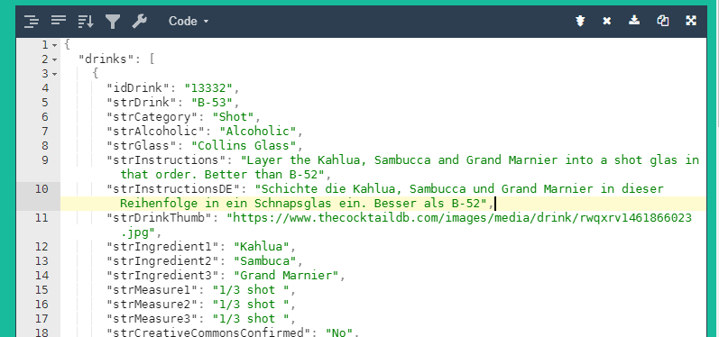
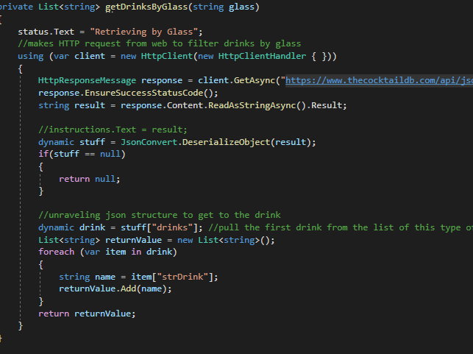
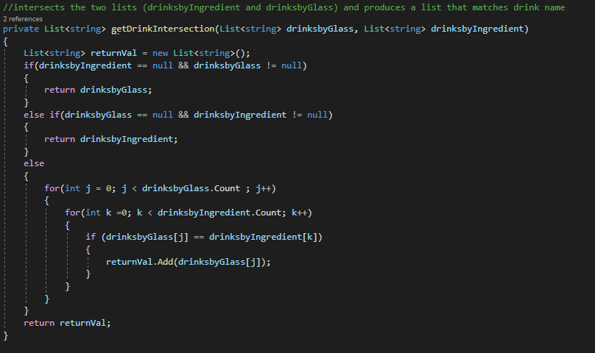
The code pulls from the API via an HTTP pull request, and processes the information
The information is returned in the form of a json, and is parsed.
Using a for loop, you find the name of every drink and add it to the list
Notes:
For the code in the bottom left corner I used 2 arrays that had an run-time complexity O(N²). The purpose of this code is to intersect the two data sets which I used in the search drop down functions, and it was great to see it come together.

Slide 4
Plan early on paper!!
Do plenty of research on available tools
Use more stub functions, so I can continue to work when I hit a wall
Not get caught up on
academic requirements
Notes:
From passion

Slide 5
New Skills:
Using APIs
Learned how to use a Winforms (GUI framework)
Figuring out what data structure was most appropriate to handle data
Calling an online API with an HTTP request to gather data and parsing a json file to get the correct information.
https://www.thecocktaildb.com/api.php
Notes:
-I was really caught up in the planning and deciding process because I was too focused on trying to meet objectives, rather than find something that is interesting
And build off that. Since Covid has been a thing, I have picked up a little bar tending skills, and going out with coworkers for happy hour reminds me of work.
SO
-My application would be ideal for a new bartender or perhaps someone at home looking to make something new
-Application gives the user several different filter options such as live text, Sorting in alphabetical order, and intersection of list data to narrow filter results.

Slide 6
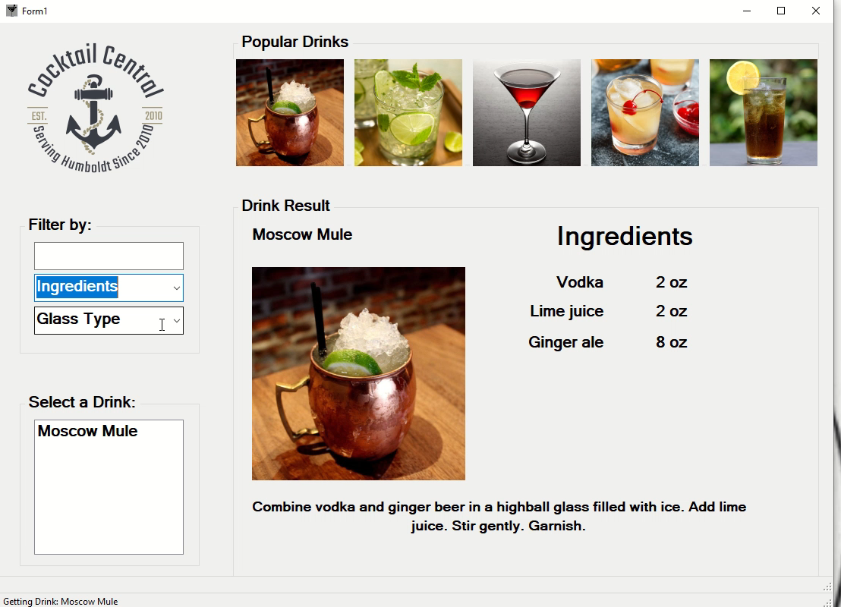
Notes:
-I was really caught up in the planning and deciding process because I was too focused on trying to meet objectives, rather than find something that is interesting
And build off that. Since Covid has been a thing, I have picked up a little bar tending skills, and going out with coworkers for happy hour reminds me of work.
SO
-My application would be ideal for a new bartender or perhaps someone at home looking to make something new
-Application gives the user several different filter options such as live text, Sorting in alphabetical order, and intersection of list data to narrow filter results.

